Slide 1
Capstone Project Report
Biodiversity for the National Parts
Presented By Aaron Zamecnik

Slide 2
Biodiversity for the National Parks
Data from the national park services includes 5541 species categorized by
Scientific name of each species
Common names of each species
Conservation status
Analysis was completed on species conservation status and grouped by
Species of concern – Declining population in need of conservation
Threatened – Vulnerable to endangerment soon
Endangered – At serious risk of extinction
In recovery – Recovering from endangerment but no longer at risk of extinction

Slide 3
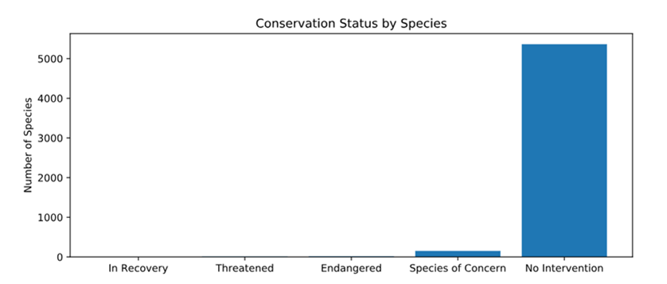
Biodiversity for the National Parks
Most species need no intervention

Slide 4
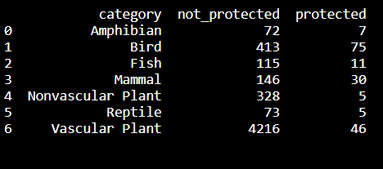
Biodiversity for the National Parks
Looking at the endanger species we discover that mammals are more likely
To become endangered than birds.
To check the significance of this
This statement we ran a chi-squared test to
evaluate if this it true.
Using the P-value of this test we can
Conclude that certain species are more
Likely to become endangered.

Slide 5
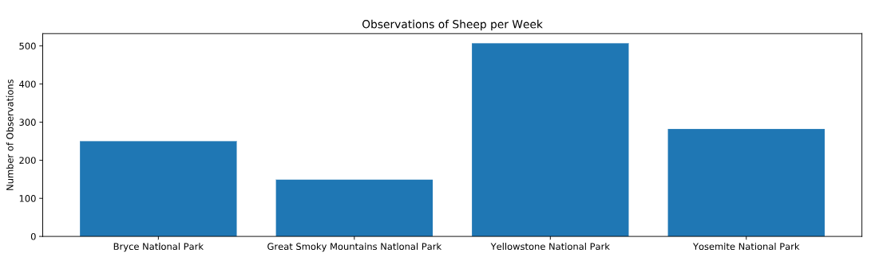
Biodiversity for the National Parks
Below is the amount of sheep required to test to measure
for a 5% reduction in foot & mouth disease.

